Slide 1
Communication Workflow — MQTT Design & Handshakes
عهدنامه و پیمان اخوت برای ارتباطات بین ماژول و سرور
15/5/1404

Slide 2
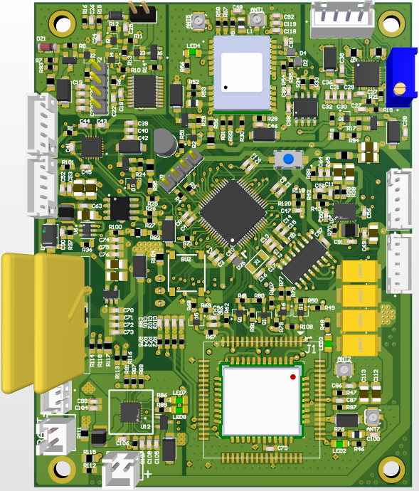
SIM7000
SIM800
GPS
RFID
RTC
Stepper
Gyroscope

Slide 3
Project Overview
The Auto Truck Lock IoT Gadget is a secure, IoT-based locking solution designed for logistics and fleet management. Installed on trucks, this device integrates GPS, SIM (cellular internet), and RFID modules to provide real-time vehicle tracking and controlled access to the truck’s cargo.
Each driver is assigned an RFID tag, which can be authorized remotely by the backend system. The gadget communicates with a central MQTT broker to:
Periodically transmit vehicle GPS location, timestamp, and battery status.
Receive remote lock/unlock commands from the backend after verifying driver credentials and vehicle location.
Publish RFID scan data to request unlock permissions.
To optimize battery life, the device uses a wake-up/sleep mechanism, only activating periodically to send updates and listen for commands. This design ensures secure, real-time monitoring and controlled access to truck cargo, even in regions with intermittent network connectivity.

Slide 4
Communication Flow Overview
The communication flow of the Auto Truck Lock Gadget is built upon MQTT protocol principles, ensuring lightweight and reliable data exchange over mobile networks. The flow includes several key operations:
Device Initialization & MQTT Connection:
Upon wake-up, the gadget establishes an MQTT connection with the broker.
The device subscribes to its command topic to receive lock/unlock instructions.
Periodic Status Publishing:
At configurable intervals, the device sends status updates containing GPS coordinates, timestamp, and battery level.
These messages are published to a designated status topic with QoS level 1 to guarantee delivery.
RFID Scan & Unlock Request:
When an RFID tag is scanned, the gadget publishes the tag ID to the backend via the broker.
The backend verifies driver authorization and sends back an unlock command to the device.
Lock/Unlock Command Handling:
The gadget listens for incoming commands on its command topic.
Upon receiving a valid unlock command, it activates the lock mechanism accordingly.
This communication workflow ensures a reliable and scalable infrastructure for managing truck locks across a fleet, even under challenging network conditions.
Visualize These contents with animations

Slide 5
Module Diagram

Slide 6
Topic structures QoS & Reliability Configurations

Slide 7
MQTT QoS & Reliability Configurations
Feature | Choice | Reason
QoS Level | QoS 1 | Ensures delivery even with intermittent connectivity. Lightweight compared to QoS 2.
*Last Will and Testament (LWT) | No | We cannot implement it with SIM800 module
*Persistent Sessions | No | Not needed
Retained Messages | Yes on some topics | Use retained messages for static config data (e.g., latest unlock command) but NOT for status updates.
Session Expiry Interval | Set to few minutes (e.g., 5 minutes) | Gives time to reconnect and receive pending commands. Prevents broker from holding stale sessions indefinitely.

Slide 8
MQTT QoS & Reliability Configurations
MQTT Client
MQTT Broker
Publish QoS 1
QoS
1
At least once - Guaranteed delivery, but can be delivered more than once.
Needs ACK.
PUBACK

Slide 9
Topics Structure
truck
<IMEA>
Status
→ Publishes GPS, timestamp, and battery level data.
rfid
→ Publishes scanned RFID tag IDs for authorization requests.
command
lock
→ Receives lock/unlock commands from the backend.
config
gyroscope
→ Receives configuration updates (gyroscope).
rfid
→ Receives configuration updates (RFID).
wit
→ Receives configuration updates (wake-up interval).

Slide 10
Topics Structure
Topic Type | Topic address | Notes
Status Data | truck/<IMEI>/status | Publishes timestamp, GPS data, battery level, Lock status, Temperature, RSSI, Counter and isQueued to server
RFID Scan | truck/<IMEI>/rfid | Publishes scanned timestamp, GPS, RFID tag serial number and requested action to server.
Command Control - lock | truck/<IMEI>/command/lock | Server publishes unlock/lock commands here.
Command Control – Gyro config | truck/<IMEI>/command/config/gyroscope | Server publishes configuration commands for Gyroscope
Command Control – Gyro config | truck/<IMEI>/command/config/rfid | Server publishes configuration commands for RFID
Command Control – Gyro config | truck/<IMEI>/command/config/wit | Server publishes configuration commands to determine the wake-up interval.

Slide 11
Topics Structure
Main topic structure
truck
<IMEI>
status
→ Publishes GPS, timestamp, and battery level data.
rfid
→ Publishes scanned RFID tag IDs for authorization requests.
command
lock
→ Receives lock/unlock commands from the backend.
config
→ Receives configuration updates (e.g., wake-up interval, gy, RFID).
diagnostic_req
→ Receive diagnostics request
diagnostic
→ Published detailed device diagnostics/logs

Slide 12
Topics Structure – for Fleet management
Fleet
Fleet ID
Truck
<IMEI>
Status
RFID
Command
Lock
config
diagnostic_req
diagnostic

Slide 13
Msg structures
Status, Command, RFID, LWT

Slide 14
Status Payload format
{
"time": “hour,minute,seccond",
"lat": 52.520008,
"lon": 13.404954,
"alt": 32.5,
"battery " : 0-9, // 9 -> means 90% to 100%, 5 means 50% to 60%
" lock status" : L/U //lock/unlock
" temperature " : 27 //temperature based on Celsius
"rssi": -78, // optional but useful for diagnostics
" counter": 7 // the Nth transmission
" is queued ": 0/1 // is msg queued or not
}
Truck
<IMEI>
Status
HH,MM,SS,Lat,Lon,Alt,Batt,Lock,Temp,RSSI,Cnt,Queued
Example messages :
“{05,23,43, 52.520008,13.404954, 32.5, 7, L, 32, 15, 150, 0}”
“{05,23,43, 52.520008,13.404954, 32.5, 7, L, 32, 15, 160, 1}”
“{05,23,43, 52.520008,13.404954, 32.5, 7, U, 32, 15, 120, 0}”

Slide 15
Command , RFID Scan and LWT Payload
{
“time": “hour,minute,seccond",
"lat": 52.520008,
"lon": 13.404954,
"alt": 32.5,
"rfid": "E2003412010901123456789A",
“action request": L/U //indicates lock/unlock
}
Truck
<IMEI>
RFID
Example messages :
“{17,40,00, 52.520008,13.404954, 32.5, E2003412010901123456789A, U}”
“{17,40,00, 52.520008,13.404954, 32.5, E2003412010901123456789A, L}”

Slide 16
Lock Command Message Structure
Truck
<IMEI>
Command
{
“command”: lock_open/lock_close
}
Lock
“{lock_open}”
“{lock_close}”

Slide 17
Config Command Message Structure
Truck
<IMEI>
Command
config
{
ON/OFF
}
gyroscope
“{off}”
“{on}”
{
ON/OFF
}
rfid
“{off}”
“{on}”
{
#second // indicates Wake-up Interval Time
}
“{wit_on_60}”
“{wit_off}”
wit
“{wit_on_240}”

Slide 18
Timing intervals
GPS and network timings

Slide 19
Timing and samplings
Sampling interval
X seconds intervals GPS sampling
GPS
Wait for WIT * 2
Wait for WIT * 2
Y seconds intervals, Network connection
Network
Conn.
#1 No network failure
Queue log, set the next network retry
#2 No network failure
Queue log, set the next network retry
Reconnection Successful.
Send all queued msgs
Queue status, no connection tryout
Queue status, no connection tryout
Queue status, no connection tryout
Queue status, no connection tryout

